Slide 1
AREC 570 Slides

Slide 2
Unit 5
Data

Slide 3
Motivation
Data collection, integration, and management is becoming an important part of economics research
Credibility revolution has simplified methods and encouraged more emphasis on clever uses of data (natural experiments)
Resolution of data has increased (space and time) - especially biophysical things (thanks satellites). We can revisit older empirical questions
Empirical results are only as strong as the quality of the data used to generate the results

Slide 4
Theory → Data or Data → Theory
Perspective 1: Your conceptual model should guide the collection and organization of your data. Otherwise, you may be finding unjustified relationships.
Perspective 2: The data should guide your investigation. Otherwise, you are twisting and forcing data to support your claims.
Pragmatic view: there are instances where you find data and realize that you can ask interesting questions about some topic or phenomenon. However, you need to be careful to go back to the early steps and identify a research questions, develop a conceptual framework, etc.

Slide 5
Primary vs Secondary Data
Primary data is collected directly from a source for a specific purpose
If you want to know what people think, then just ask them – Patty Champ
Survey, observation (passive monitoring)
In survey, data quality is your responsibility, but analysis is usually more straightforward
Secondary data was collected for another purpose but can provide important information needed to test some hypothesis

Slide 6
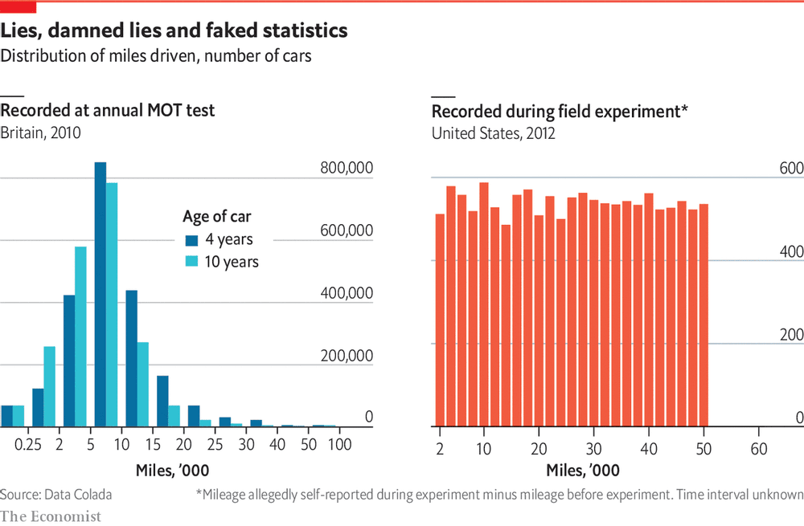
Trust
How do you know if you can trust data?
Source reputation
Clear and comprehensive documentation. See Census or BLS
Statistical tests of data validity - Dan Ariely
Institutional knowledge of dataset

Slide 7
Sampling
You want the data to be representative sample of intended population
In publicly collected surveys, you may also find survey weights (ex post) that need to be used to get population level estimates.
Survey weights can account for over sample groups or undersampled groups
Varian (2014) notes that while working at google, he finds that 0.1% is usually sufficient for analysis of business data. Cell data may be similar.

Slide 8
Other Considerations: Institutional Knowledge
Invest in institutional knowledge
How was the data collected? Trust/reliable

Slide 9
Other considerations: Types of data
Time series: data measured over time (asset prices)
Cross sectional: data measured over a group of agents without regard to time
Longitudinal, panel, or cross section time series data
Balanced panel
Unbalanced panel

Slide 10
Other considerations: Aggregation
Temporal aggregation: how fine do you need time… market prices by second or by year
Spatial aggregation: localized (geographic coordinates) up to national or global
Aggregation obscures heterogeneity (maybe that is important to your question)

Slide 11
Champ –
Collecting Nonmarket Valuation Data

Slide 12
Understand the objectives of the survey
What is the research question you are trying to answer?
What is the value of some resource?
What affect does question ordering have on responses?

Slide 13
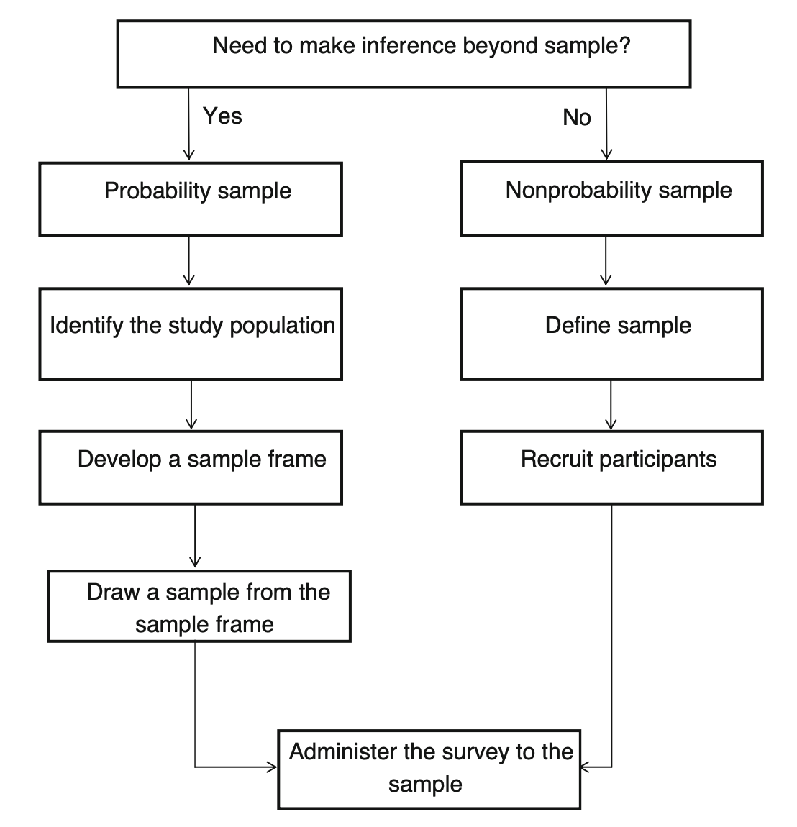
Sampling
Non prob sampling – students, people at grocery store
Prob sampling
- who is the population impacted by the policy or change?

Slide 14
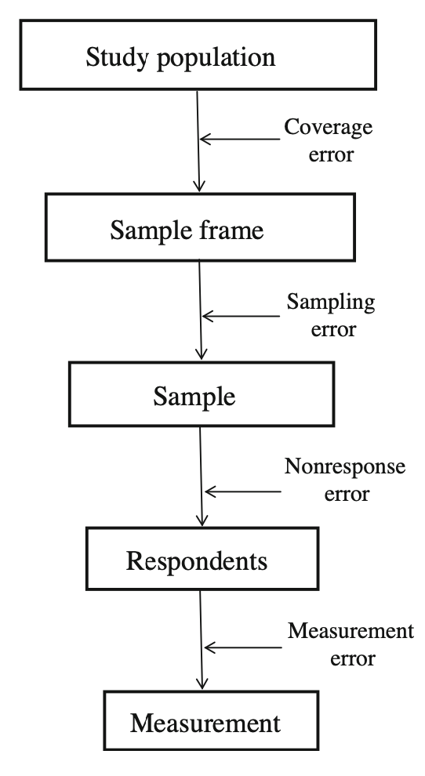
Sampling Sources of Error
Sampling frame is the population you are able to survey
Under/over coverage is the misalignment of pop to be surveyed and study population
Sampling
Simple random sampling vs more complex strategies
Power analysis to determine sample size
Power = 1 – prob type 2 error
Quota sampling to get respondents with specific attributes or behaviors: consumers of a certain good
Notes:
Patty describes valuing free wifi to a community
Undercoverage is the sample frame excludes people that may be affected. Homeowners in a neighborhood may exclude renters
Overcoverage is including people that won’t be impacted. May include people that recently moved.
Clustered or stratified random sampling
Clustered is representative but near for ease of administering the survey
Stratified to ensure you get representation in all subgroups

Slide 15
Sampling Sources of Error
Non-response error occurs when parts of the sample don’t respond
How can you test for non-response?
Notes:
You can test by comparing attributes of your sample to attributes of the sample frame

Slide 16
Questionnaire design
Be as clear and consistent as possible
Ask about a single thing in the question and provide consistent response choices
Avoid switching positive and negative statements if asking for agreement
Focus group and pretesting can help mitigate issues

Slide 17
Survey mode
Self-administered vs interviewer-administered
Interviewer-administered (e.g., intercept) – more control but may embed interviewer effects or social desirability bias
Self-administered can be more convenient, but analyst loses some control (e.g., question order)
Online (e.g., Qualtrics) – pay for the responses you get, but there are concerns about professional survey takers (Amazon Mechanical Turks)

Slide 18
Survey Administration
Administration can be complex. Stay organized
Ensure confidentiality if needed. Most surveys of people require IRB approval or exemption.

Slide 19
Survey processing
Develop codebook to make clear how responses are coded
Software now exists to help minimize data entry errors
Carefully document procedures – for your future self and when writing papers

Slide 20
Accessing Data via API

Slide 21
Motivation
More and more data are becoming available all the time
Application Programming Interfaces (API) are becoming standard across the web
  They provide a structure for accessing information (**not webscraping**)
Examples:
  BLS

Slide 22
USDA NASS

Slide 23
Cropscape

Slide 24
tidycensus

Slide 25
APIs are not always the best option
If you plan to process large amounts of information (e.g., all of US), you may be better off downloading bulk data

Slide 26
Gentzkow and Shapiro:
Code and Data for the Social Sciences

Slide 27
Motivation
Most empirical projects require obtaining, organizing, analyzing data – these datasets are getting larger
Econ researchers spend a lot of time writing/debugging code, but most of us have no formal training
Issues: trying to reproduce results, change things, extend analyses all were time consuming and often didn't work
"If you are trying to solve a problem, and multi-billion dollar firms depend on solving the problem, and there are whole courses at your university devoted to solving that problem, you might want to figure out how they solve the problem."

Slide 28
Automation
Automate everything that can be automated; Write a single script that executes all code from beginning to end.
Why script rather than run in interactive mode?
Reproducibility: authoritative record of what was done
Efficiency: easier/faster to make upstream changes and rerun entire analysis
Write a "make" script – a simple script that tells the computer what to run in which order

Slide 29
Version Control
Have you ever appended "v2" or your initials or a date to a draft? Me too
Version control is like track changes and dropbox for code (plus some extras)
Git is a version control software that runs locally
Github is an online repository for archiving and collaborating on projects via git
Github is good for code and small data files; large files should be stored elsewhere
https://happygitwithr.com/ for R users

Slide 30
Directories
Separate directories by function; separate files into inputs and outputs; make portable
Build/analysis structure:
https://github.com/jbayham/weather_risk_resource_orders
Consistent organizational structure makes dirs easy to read and files easy to find

Slide 31
Keys
Store cleaned data with unique non-missing keys
State and county population example
GS use it as an example for why to think in terms of relational database but it is also a good example of "tidy data"
Each table has a variable that uniquely identifies the row (key)
This key from one table may exist as a non-unique variable in other tables – you can use these to join
I prefer numeric keys when possible to avoid confusion with names (e.g., counties, fires)

Slide 32
Abstraction
Abstraction is the idea of writing code that solves a problem more generally than your one specific instance (e.g., tidy to coeftest)
If you find yourself copying and pasting code, try to find a more general solution and call on it

Slide 33
Documentation
Documentation helps future you and others understand what you've done and how to interact with the files
GS argue to integrate limited comments in code; make code so clear it doesn't need comment (self documenting)
Use full variable names rather than v1 through v200

